Slide 1
Final Report - Recommendation system
Machine Learning Capstone - IBM Professional Certificate
By / Adham Ashraf Salah
Date: 16/9/2024

Slide 2
Executive Summary
The main goal of this project is to improve learners' learning experience via helping them quickly find new interested courses and better paving their learning paths. Meanwhile, with more learners interacting with more courses via your recommender systems, your company's revenue may also be increased.
This project is currently at the Proof of Concept (PoC) phase so the main focus at this moment is to explore and compare various machine learning models and find one with the best performance in off-line evaluations.

Slide 3
Table Of Contents (TOC):
Introduction (Capstone Overview)
Exploratory Data Analysis and Feature Engineering
Content-based Recommendation System using unsupervised Learning
Collaborative filtering-based Recommendation System using supervised learning
Conclusion
Future Improvements

Slide 4
Machine learning pipeline
Collecting and understanding data
Performing exploratory data analysis on online course enrollments datasets
Extracting Bag of Words (BoW) features from course textual content
Calculating course similarity using BoW features
Building content-based recommender systems using various unsupervised learning algorithms, such as: Distance/Similarity measurements, K-means, Principal Component Analysis (PCA), etc.
Building collaborative-filtering recommender systems using various supervised learning algorithms
K Nearest Neighbors, Non-negative Matrix Factorization (NMF), Neural Networks, Linear Regression, Logistic Regression, RandomForest, etc.
Deploying and demonstrate modeling via a web app built with streamlit. Streamlit is an open-source app framework for Machine Learning and Data Science to quickly demonstration.
Reporting in paper.

Slide 5
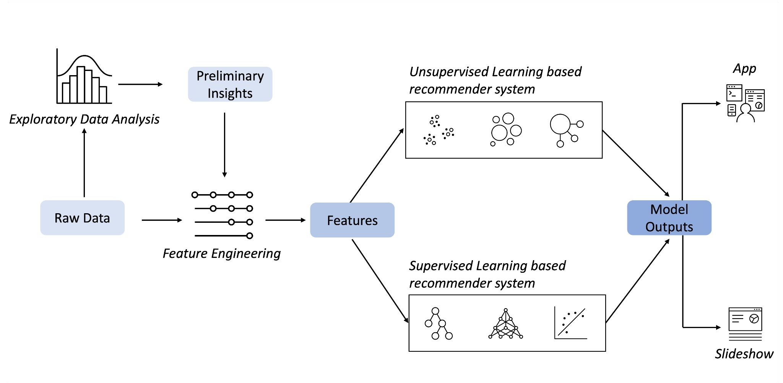
Recommender Systems Machine learning pipeline

Slide 6
Exploratory Data Analysis
and Feature Engineering

Slide 7
In this exploratory data analysis, the utilization of WordCloud visualization unveils prevalent keywords within a dataset of online course titles. By aggregating and filtering course titles, dominant themes such as Python, data science, machine learning, big data, AI, TensorFlow, containers, and cloud computing are identified. This analysis provides valuable insights into the trending IT skills and subject areas covered by the online courses, guiding learners and educators in understanding the current landscape of digital learning opportunities.

Slide 8
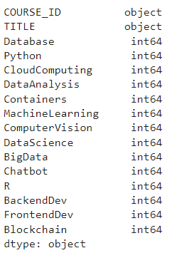
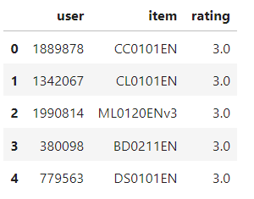
Exploratory Data Analysis
Describe statistics of data sets
There are two data sets one for courses and one for ratings
There are 307 courses total

Slide 9
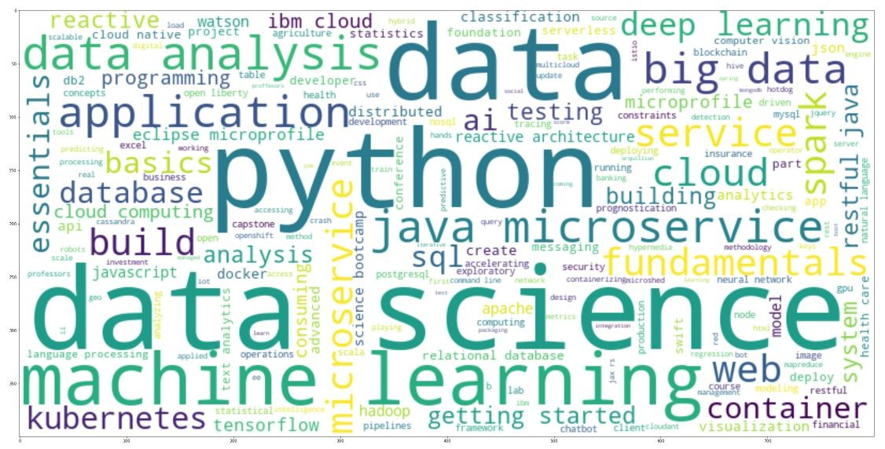
Plot a Word Cloud from Course Titles
As we can see from the word cloud, there are many popular IT-related keywords such as python, data science, machine learning, big data, AI, tensorflow, container, cloud, etc.

Slide 10
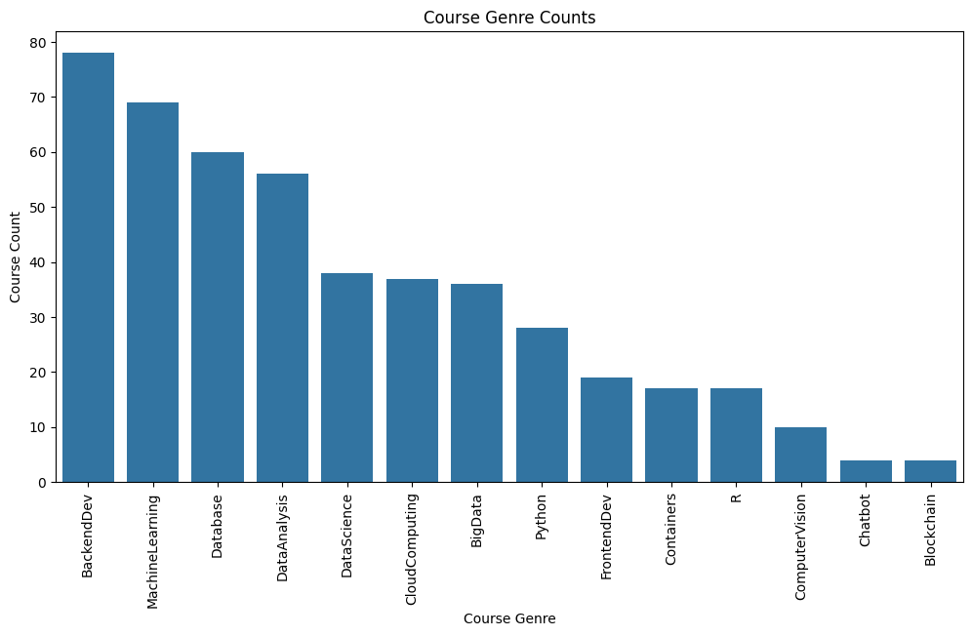
Determine popular course genres
The analysis revealed that Backend Development, Machine Learning, and Database courses are among the most prevalent, while Blockchain and Chatbot courses are less common. This exploration provides valuable insights for learners and educators seeking to understand current trends in online education.

Slide 11
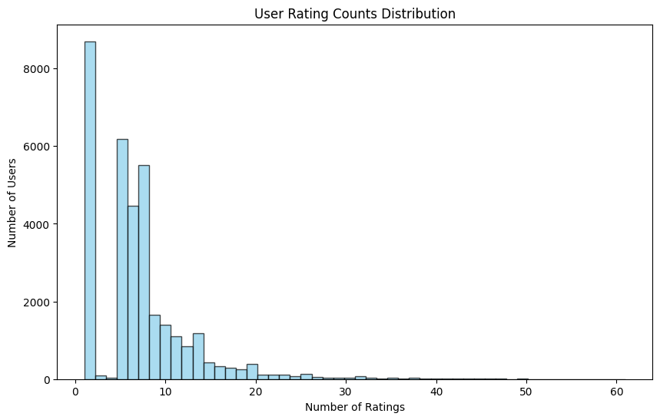
Understanding User engagement and interaction
By aggregating the rating counts for each user, it was found that the dataset comprises 233,306 enrollment records from 5,000 unique users. The histogram distribution of user rating counts illustrates varying levels of engagement, with the majority of users giving relatively few ratings while a smaller proportion giving a larger number of ratings.

Slide 12
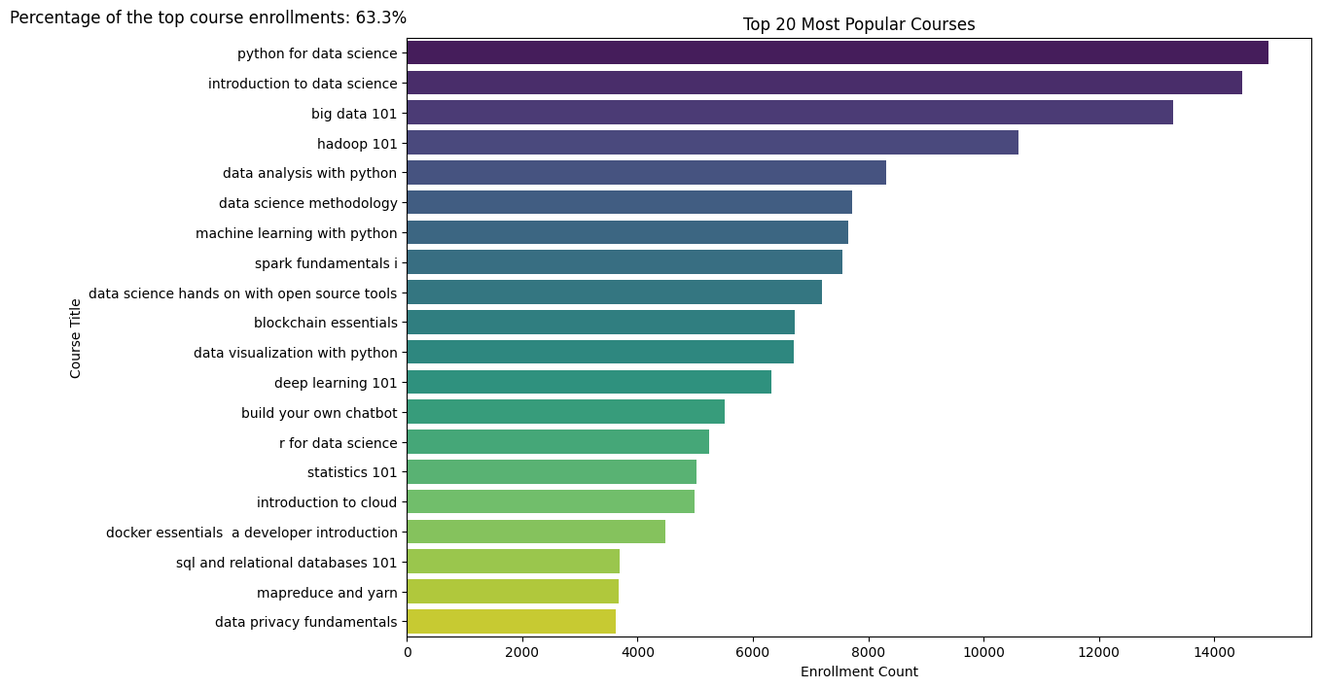
Identifying the 20 most popular courses
In this task, the objective was to determine the top 20 most popular courses based on enrolment counts. Using the enrolment data, the courses were aggregated, and sorted, and the top 20 courses were identified. The resulting list showcases the titles and enrollment counts of these highly sought-after courses, providing insights into the preferences of learners in the online learning platform.

Slide 13
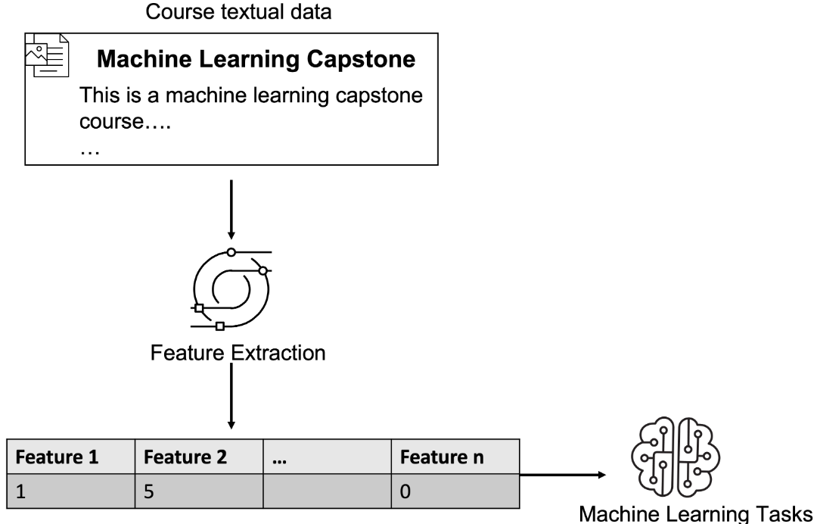
Feature Engineering
Machine learning algorithms cannot work on an item directly so we first need to extract features and represent the items mathematically, i.e., with a feature vector.
Many items are often described by text so they are associated with textual data, such as the titles and descriptions of a movie or course. Since machine learning algorithms can not process textual data directly, we need to transform the raw text into numeric feature vectors.

Slide 14
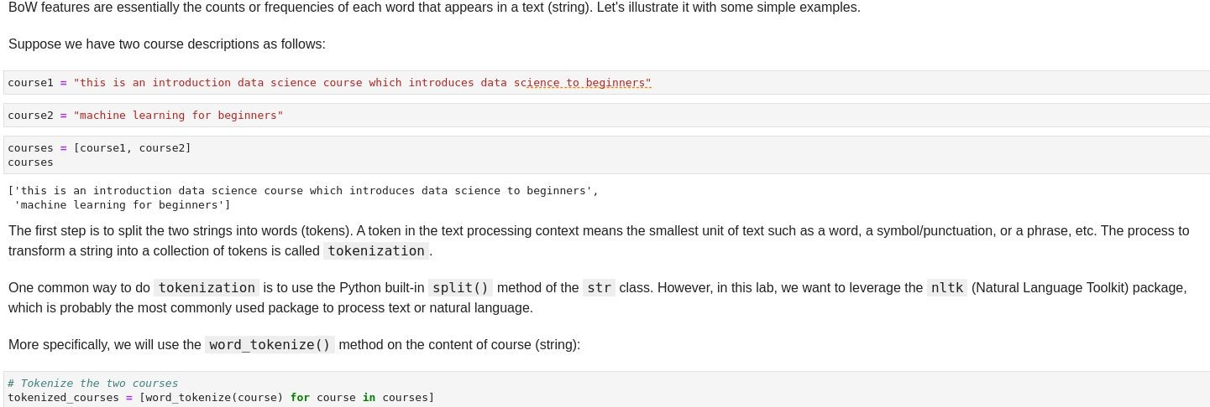
Feature Engineering - BoW
A document may contain tens of thousands of words which makes the dimension of the BoW feature vector huge.
To reduce the dimensionality, one common way is to filter the relatively meaningless tokens such as stop words or sometimes add position and adjective words.

Slide 15
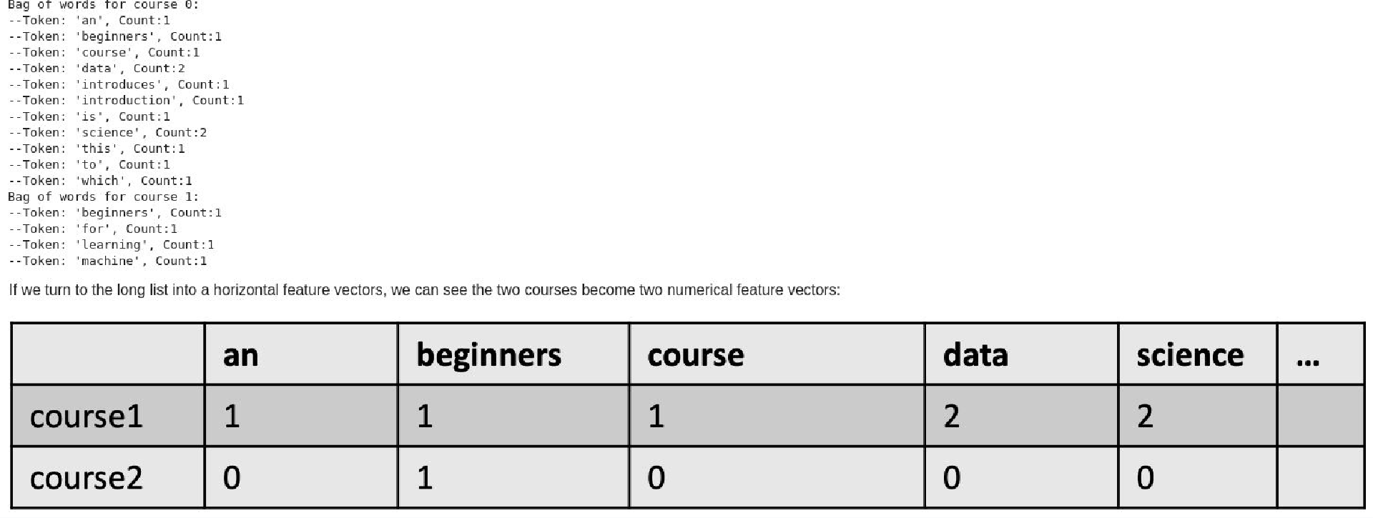
Feature Engineering - BoW

Slide 16
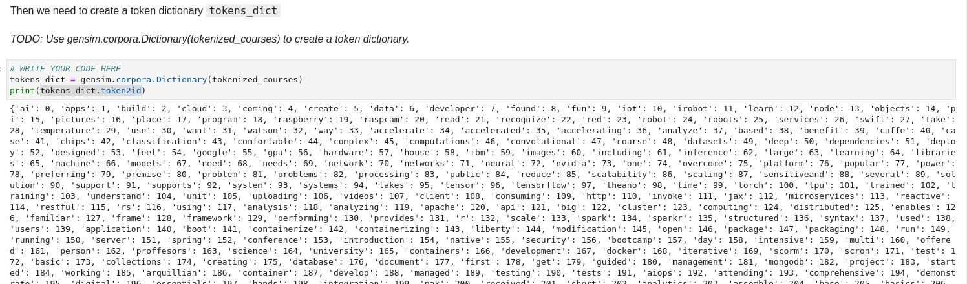
Feature Engineering - BoW
Extract BoW features for course textual content and build a dataset

Slide 17
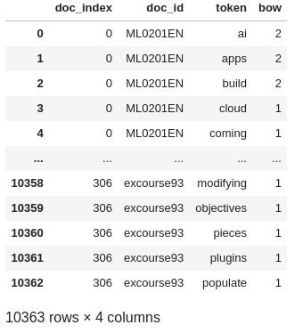
Feature Engineering - BoW
Extract BoW features for course textual content and build a dataset
Create a new course_bow dataframe based on the extracted BoW features. he new dataframe needs to include the following columns (you may include other relevant columns as well):
'doc_index': the course index starting from 0
'doc_id': the actual course id such as ML0201EN
'token': the tokens for each course
'bow': the bow value for each token

Slide 18
Content-based Recommendation System Using Unsupervised Learning

Slide 19
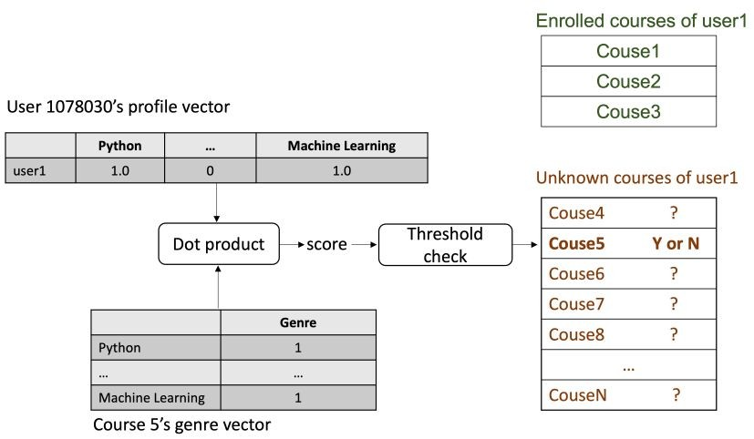
1. Content-based Course Recommender System using User Profile and Course Genres
Raw data EDA Feature engineering
Get recommend
Recomendation
score
Course genres dataframe:
course_id, title, [genre_x, genre_y,...]
User dataframe: user_id, [genre_interest_x, genre_interest_y,...]
Analysis data
Drop the exceptions Normalise data
Use dot product between single user vector and specific course to get recommend score
Make prediction by comparing score with determine threshold

Slide 20
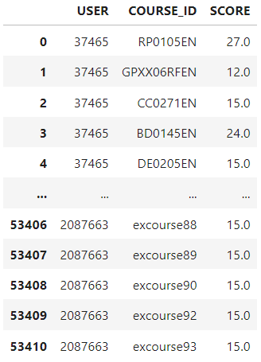
1. Content-based Course Recommender System using User Profile and Course Genres
Hyper-parameter Settings:
In our discussion, we set a recommendation score threshold of 10.0 to filter out low-scoring recommendations. This threshold determines which courses are considered relevant enough to be recommended to users. Additionally, we may have adjusted other hyperparameters such as feature representation methods or similarity metrics during the implementation of the recommender system.
Average Number of New Courses Recommended per User:
We calculated the average number of new courses recommended per user in the test user dataset. This metric helps evaluate the coverage and diversity of the recommender system. In our case, the average number was approximately 61.82 courses per user.
Top-10 Most Frequently Recommended Courses:
The table represents the top 10 most frequently recommended courses based on the user profile- based recommender system. Each row corresponds to a course, identified by its COURSE_ID, and the number of times that course has been recommended to users, denoted by the RECOMMENDATION_COUNT column. These recommendations are generated by analyzing user profiles and course genre vectors, with courses scoring higher in relevance to a user's interests being recommended more frequently.

Slide 21
2. Content-based Course Recommender System using Course Similarities
Raw data
Data processing
Cleaned Feature
datasets Engineering
Features
Let's break down the flowchart based on the conversation we had:
Raw Data: Refers to the initial dataset containing information about various courses, including their titles, descriptions, and other relevant attributes.
Data Processing: Involves preprocessing the raw data, which includes tokenization and lemmatization to break down the text into individual words and convert
them to their base forms..
Cleaned Dataset: After processing, the dataset undergoes cleaning, which includes removing stopwords (commonly used words with little semantic value) and
outliers (irrelevant or noisy data points).
Feature Engineering: This step involves transforming the cleaned dataset into numerical features that represent the courses. In this case, TF-IDF (Term
Frequency-Inverse Document Frequency) vectors are calculated for each course based on the words they contain and their importance in the dataset.
Features: Refers to the final set of features used to represent each course, which are the TF-IDF vectors obtained from the feature engineering step. These
features are then used to calculate similarities between courses and generate recommendations based on content similarity.

Slide 22
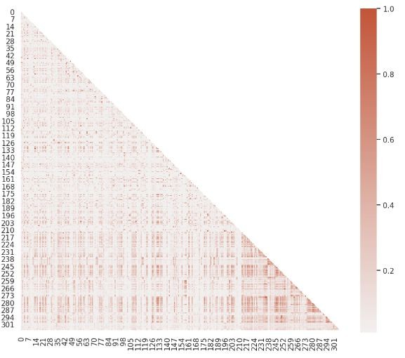
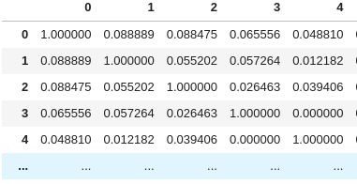
2. Content-based Course Recommender System using Course Similarities
Course similarity matrix:

Slide 23
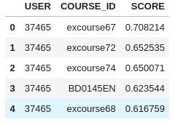
2. Content-based Course Recommender System using Course Similarities
Generate course recommendations based on course similarities for all test users
Top-5 Most Frequently Recommended Courses

Slide 24
3. Clustering based Course Recommender System
Raw data
Features
Clusters
Prediction
Raw data:
User profile dataframe: user_id, [genre_x, genre_y,...]
Features:
Normalise user profile features
Apply PCA to keep only important features
Apply Clustering algorithms to group similar courses
Make recommendation by taking courses in user’s interest group

Slide 25
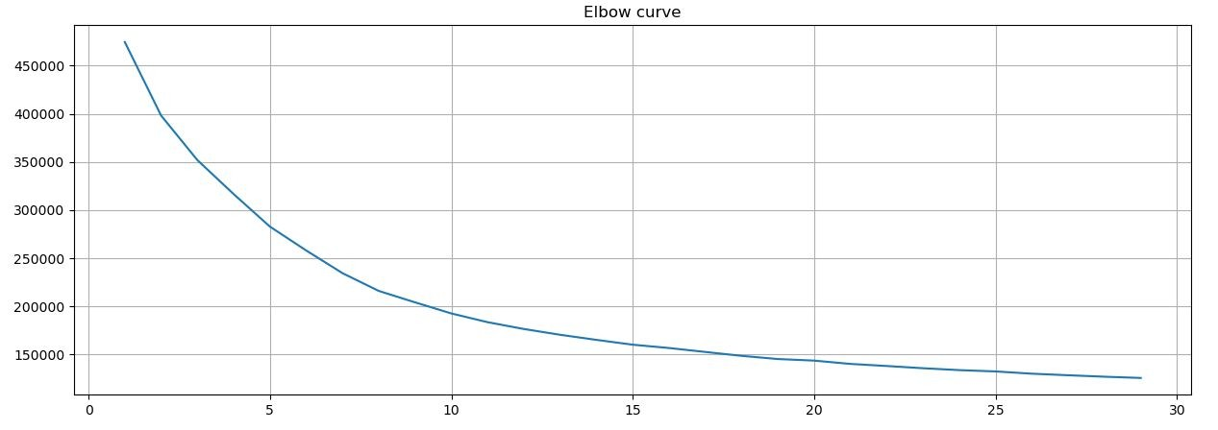
3. Clustering based Course Recommender System
For KMeans algorithm, one important hyperparameter is the number of clusters n_cluster, and a good way to find the optimized n_cluster is using to grid search a list of candidates and find the one with the best or optimized clustering evaluation metrics such as minimal sum of squared distance.
Grid search the optimized n_cluster for KMeans() model

Slide 26
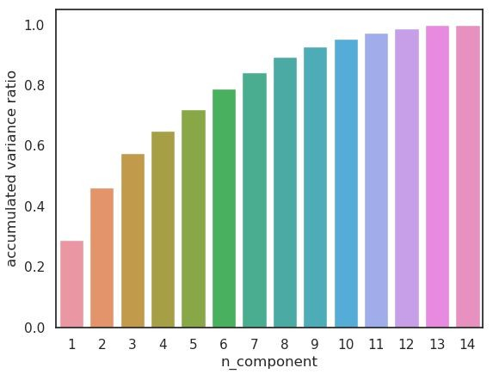
3. Clustering based Course Recommender System
Apply the PCA() provided by scikit-learn to find the main components in user profile feature vectors and see if we can reduce its dimensions by only keeping the main components.
If the accumulated variances ratio of a candidate n_components is larger than a threshold, e.g., 90%, then we can say the transformed n_components could explain about 90% of variances of the original data variance and can be considered as an optimized components size.
We select n_component = 8, due to the minimal ratio > 0.9

Slide 27
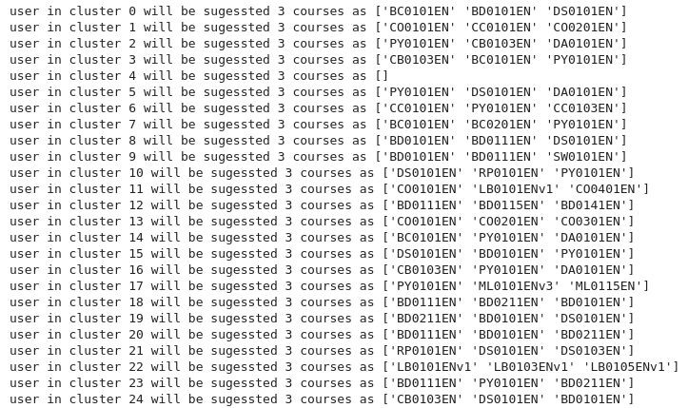
3. Clustering based Course Recommender System
After applying PCA to features:
Find popular courses in clusters and suggest to user in cluster:
Insights:
On average, how many new/unseen courses have been recommended per user (in the test user dataset)
What are the most frequently recommended courses? Return the top-10 commonly recommended courses
Our analysis of the most frequently recommended courses revealed compelling insights into the preferences of users within each cluster.

Slide 28
Collaborative filtering-based recommendation system using supervised learning

Slide 29
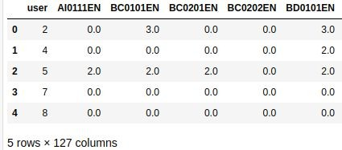
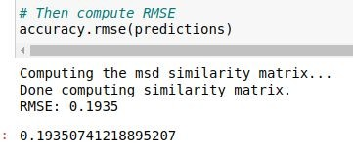
1. CF using K Nearest Neighbour
Raw data
Spare data
Model
Prediction
User - item - rating - dataframe: user_id, item, rating
Use pivot method in pandas to turn data to features
Fit data to KNN model based on surprise library
Use distance metric listed in previous page
Make prediction by test data, use RMSE metric to evaluate model performance

Slide 30
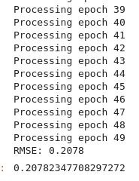
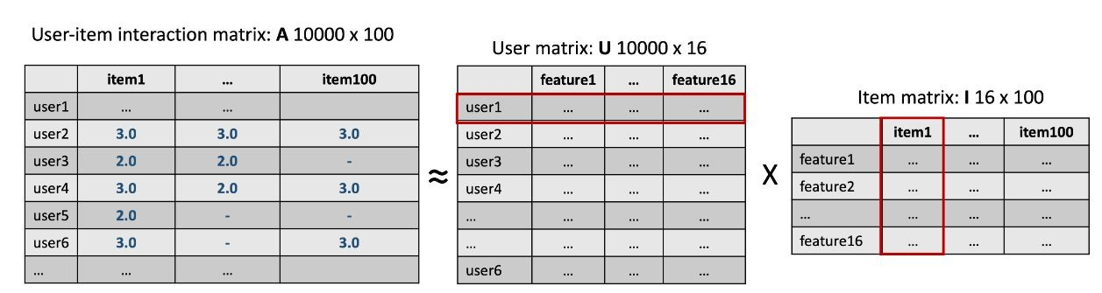
2. CF using Non-negative Matrix Factorization - Pipeline & Result#
Raw data Decomposed matrix
Model Prediction
User - item - rating - dataframe: user_id, item, rating
Use surprise library to decompose full matrix to two smaller and denser ones: user matrix and item matrix
Dot product each row in user matrix with each column in item matrix
Make prediction by test data, use RMSE metric to evaluate model performance

Slide 31
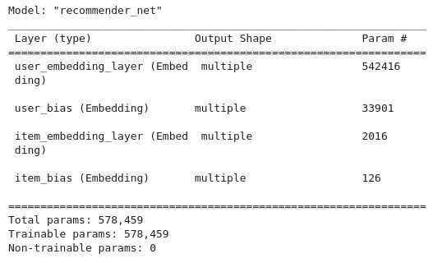
3. Course Rating Prediction using Neural Networks
Model:
Optimizer: Adam
Loss: Mean Square Error
Metric: Mean Square Error
Epoch 12
Batch size: 512

Slide 32
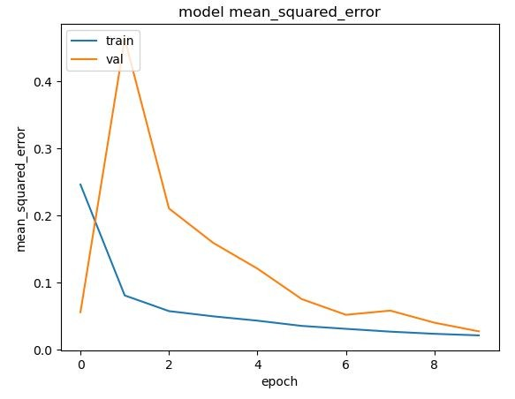
3. Course Rating Prediction using Neural Networks
Result on test data:
Mean squared error:: 0.0235
Root mean squared error: 0.1534

Slide 33
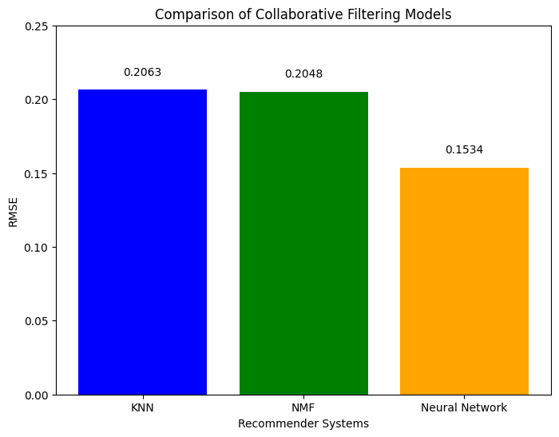
Compare the performance of collaborative-filtering models
Based on the evaluation results, the Neural Network Embedding-based recommender system achieved the lowest RMSE value of 0.1534, indicating the best performance among the three models in predicting user-item interactions. Therefore, we consider the Neural Network Embedding-based recommender system to be the most effective model for collaborative filtering in this scenario.

Slide 34
Conclusion

Slide 35
Conclusion of Exploratory Data Analysis EDA
From the various analyses conducted, several key insights can be drawn regarding the online learning platform's course offerings and user engagement. Firstly, the exploration of course genres revealed a diverse array of topics, with backend development, machine learning, and databases emerging as the most popular genres based on enrollment counts. Additionally, the analysis of course enrollments shed light on user behavior, indicating that a significant portion of users completed courses rather than merely auditing them. Furthermore, the examination of the top 20 most popular courses showcased a strong interest in data-related topics such as Python for Data Science, Introduction to Data Science, and Big Data 101, reflecting the growing demand for skills in data analysis and machine learning. Overall, these findings underscore the importance of providing a wide range of courses that cater to diverse interests while also highlighting the significance of data-driven insights in optimizing course offerings and enhancing user engagement on the platform.

Slide 36
Conclusion of Content-based recommender system using user profile
The Content-based Recommender System Using User Profile And Course Genres begins with setting up the task of generating course recommendations based on user profile and course genre vectors. The process involves loading user profiles and course genre dataframes, extracting user interests, identifying unknown courses for each user, computing recommendation scores, and filtering out courses below a specified threshold. After completing the recommendation scores for all test users, the analysis focuses on evaluating the system's performance. This includes determining the average number of recommended courses per user and identifying the top 10 most frequently recommended courses across all users. The average number of recommended courses per user is approximately 61.82, indicating a substantial number of recommendations per user. The most frequently recommended courses include "TA0106EN," "GPXX0IBEN," and others, demonstrating their popularity among the recommended courses.

Slide 37
Conclusion of content-based recommender system using course similarity
The conclusion drawn from the content-based recommender system using course similarity is that a course similarity-based recommender system has been successfully implemented and evaluated. The system utilizes a similarity threshold of 0.6 to recommend courses to users based on their interests and previously selected courses. By analyzing course content and calculating similarities, the system provides personalized recommendations to users. The evaluation of the recommender system revealed valuable insights, including the average number of new courses recommended per user and the most frequently recommended courses. These findings highlight the effectiveness and performance of the system in suggesting relevant and engaging content to users. Additionally, the evaluation results inform potential optimizations and improvements for enhancing the recommender system's effectiveness in future iterations. Overall, the conclusion underscores the importance and effectiveness of utilizing course similarity-based approaches in providing personalized recommendations to users in educational settings.

Slide 38
Conclusion of cluster-based recommender system
In conclusion, our course clustering-based recommender system demonstrates robust performance in effectively grouping users based on their preferences and recommending relevant courses. The optimization of hyperparameters, including the determination of cluster numbers and PCA components, ensures that the system accurately captures user preferences while minimizing information loss. Through meticulous evaluation, we found that the system recommends an average of approximately 36.587 new or unseen courses per user in the test dataset, indicating its effectiveness in diversifying recommendations. Furthermore, the identification of frequently recommended courses such as "WA0101EN," "DB0101EN," and "DS0301EN" provides valuable insights into user preferences and highlights the system's ability to promote popular courses across different clusters. Overall, our recommender system serves as a valuable tool for enhancing user engagement and satisfaction by delivering personalized course recommendations aligned with individual learning objectives.

Slide 39
Conclusion of collaborative filtering (KNN, NMF, and Neural Network)
Based on the comparative analysis of the three collaborative filtering methods, including KNN-based, NMF-based, and Neural Network Embedding-based recommender systems, several insights can be gleaned. Firstly, both the KNN-based and NMF- based recommender systems exhibit relatively higher RMSE values compared to the Neural Network Embedding-based approach. This suggests that the Neural Network Embedding-based method better captures the underlying patterns and latent features within the user-item interaction data, resulting in more accurate predictions. Additionally, the Neural Network Embedding-based approach benefits from its ability to learn complex nonlinear relationships between users and items, allowing it to uncover subtle preferences and nuances in the data. However, it's worth noting that while the Neural Network Embedding- based method outperforms the other two approaches in terms of prediction accuracy, it may require more computational resources and longer training times due to its deeper architecture and higher complexity. Therefore, the choice of the most suitable collaborative filtering method depends on the specific requirements and constraints of the recommendation system, balancing between prediction performance and computational efficiency.
KNN
NMF
ANN
RMSE
0.2063
0.2048
0.1534

Slide 40
Future Improvements

Slide 41
More improvements in the Future
This project showcases the implementation of an end-to-end machine learning pipeline. While it successfully meets the course objectives, there are several potential improvements to enhance accuracy and overall performance:
Working with real-world customer data for more practical insights.
Incorporating advanced pre-processing techniques.
Efficiently managing sparse data to avoid excessive memory usage.

Slide 42
Thanks for your reading!

